Slide 1
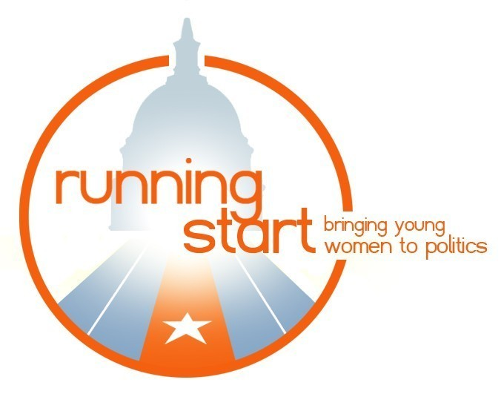
Running Start
Bringing Young Women to Politics
Google Online Challenge and Analytics
Section - 0502
Team - F
Notes:
Young Women's Political Leadership Program Week-long retreat in July includes workshops led by experts in the field on public speaking, messaging, networking, on-camera media training, and platform development.
Elect Her
Daylong training for college women on how to run for student government on your campus.
Star Fellowship The Running Start/Walmart Star Fellowship program brings 14 college women to Washington, DC each year to learn about politics first-hand.
Run with Running Start Run With Running Start accepts submissions from alumni of Running Start programs and chooses 10 participants to compete in a mock political election.
How We Do It
Running Start has six training programs for high school, college-aged, and recently graduated young women. They are: the Young Women’s Political Leadership Program; the Summit; Elect Her; the Running Start / Walmart Star Fellowship; the Running Start Internship Program; and Run with Running Start. Each program combines skills training from experts (in fundraising, public speaking, messaging, networking, and campaign team building) and mentoring by women in politics. We find that our program participants leave with the confidence to run now (for student government and local office) and the desire and skills to run in the future!

Slide 2
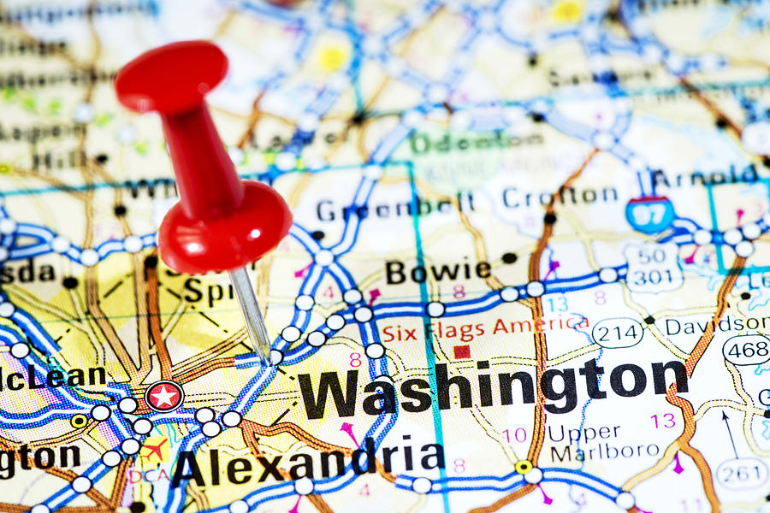
Client Overview
Nonpartisan non-profit organization
Trains young women to run for public office
Trainings Programs Offered : High School Program, Elect Her, Congressional Fellowship, Mentorship
Social Media Campaigns : #ElectHer, #ILookLikeAPolitician
Notes:
Young Women's Political Leadership Program Week-long retreat in July includes workshops led by experts in the field on public speaking, messaging, networking, on-camera media training, and platform development.
Elect Her
Daylong training for college women on how to run for student government on your campus.
Star Fellowship The Running Start/Walmart Star Fellowship program brings 14 college women to Washington, DC each year to learn about politics first-hand.
Run with Running Start Run With Running Start accepts submissions from alumni of Running Start programs and chooses 10 participants to compete in a mock political election.
How We Do It
Running Start has six training programs for high school, college-aged, and recently graduated young women. They are: the Young Women’s Political Leadership Program; the Summit; Elect Her; the Running Start / Walmart Star Fellowship; the Running Start Internship Program; and Run with Running Start. Each program combines skills training from experts (in fundraising, public speaking, messaging, networking, and campaign team building) and mentoring by women in politics. We find that our program participants leave with the confidence to run now (for student government and local office) and the desire and skills to run in the future!

Slide 3
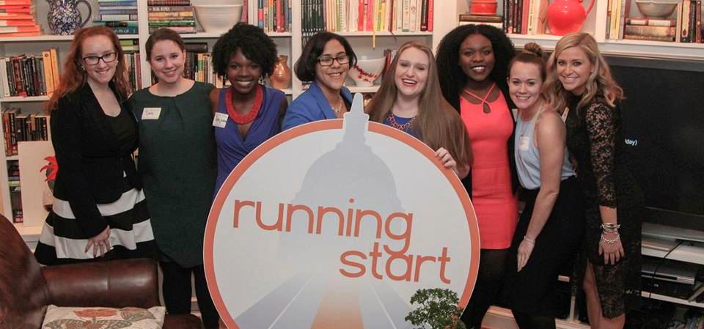
Client Overview
Social Media Presence:
LinkedIn : 958
Facebook : 7,7,64 likes, 8014 followers
Instagram : 2769
Twitter : 12,400
Notes:
Young Women's Political Leadership Program Week-long retreat in July includes workshops led by experts in the field on public speaking, messaging, networking, on-camera media training, and platform development.
Elect Her
Daylong training for college women on how to run for student government on your campus.
Star Fellowship The Running Start/Walmart Star Fellowship program brings 14 college women to Washington, DC each year to learn about politics first-hand.
Run with Running Start Run With Running Start accepts submissions from alumni of Running Start programs and chooses 10 participants to compete in a mock political election.
How We Do It
Running Start has six training programs for high school, college-aged, and recently graduated young women. They are: the Young Women’s Political Leadership Program; the Summit; Elect Her; the Running Start / Walmart Star Fellowship; the Running Start Internship Program; and Run with Running Start. Each program combines skills training from experts (in fundraising, public speaking, messaging, networking, and campaign team building) and mentoring by women in politics. We find that our program participants leave with the confidence to run now (for student government and local office) and the desire and skills to run in the future!

Slide 4
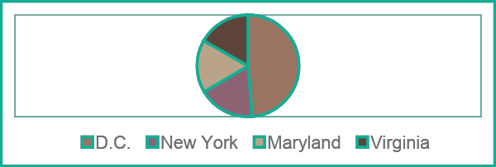
Target Markets and Current Marketing
Target Audience : varies from adolescents to recent graduates
Audience Trends: Q1 2018, Q2 2018 has more users
Target Areas:
89% from the USA
11% from countries like China, Brazil, Germany ,France
Current Marketing Strategy :
Alumni Network
Social Media Platforms
Word of mouth

Slide 5
Competitive Landscape and Client's USP
Major Competitors
Michigan Political Leadership (MPLP)
Sorensen Institute for Political Leadership
American Council of Young Political AYCPL
Unique Selling Point
Located at the hub for USA’s political and federal activities – greater networking opportunities, we would be targeting the location advantage in all our campaigns
Exclusively for women

Slide 6
Adwords Structure
Program & Events
High School Program Sample Keywords: “high school politics program” "confident women", "weeklong summer training"
College Programs Sample Keywords: "Elect Her", "run for student government”, “congressional fellowship”
Alum Program Sample Keywords: "Running start alum", "social campaign to inspire", "online political mentoring"
Negative Keywords: -"running shoes", -"running women"
Brand Awareness & Get Involved
Donate Sample Keywords: "donate to empower women", "sponsor a training", "non profit in dc", "make a contribution"
Brand Awareness Sample Keywords: " running start women", "political office training ", "training for young women"

Slide 7
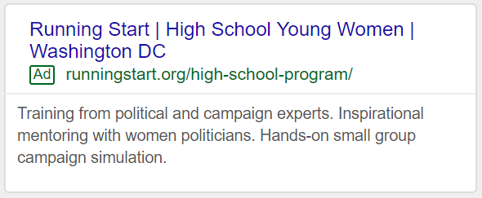
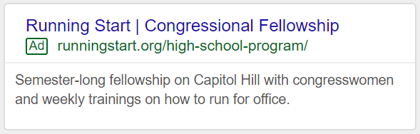
Budget Board
Budget Breakdown | Weekly Budget Spent | Program & Events Campaign (65%) | Brand Awareness & Get Involved (35%)
Week 1 (25%) | $62.50 | $40.625 | $21.875
Week 2 (35%) | $87.50 | $56.875 | $30.625
Week 3 (40%) | $100 | $65 | $35
Total for Campaigns | $250 | $162.5 | $87.5

Slide 8
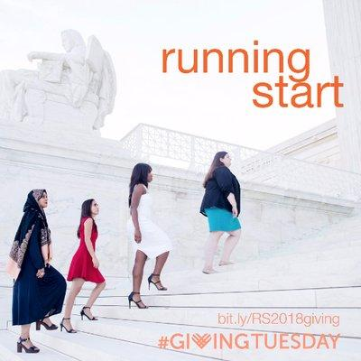
Macro and Micro Conversions
Micro Conversions
Mentorship
Pdf downloads
Social Media Campaigns
Returning Users
Macro Conversions
Donation
Program Application
Program Fee

Slide 9
Conversions, Goals, Performance Metrics
Website metrics from March 21, 2018 to March 21, 2019 (Source : Google Analytics)
Metric | Values
New users | 25,845 (88.4%)
Returning users | 3,404 (11.6%)
Sessions/user | 1.27
Pages/session | 1.93
Bounce rate | 65.98%
Metric | Values
Organic search | 17,049 (63.63%)
Direct | 7,139 (26.64%)
Referral | 1,826 (6.81%)
Social | 768 (2.87%)
Email | 12 (0.04%)

Slide 10
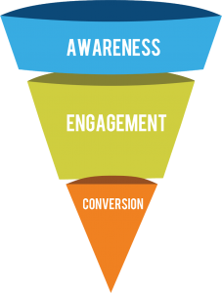
Conversions, Goals, Performance Metrics
Conversion Funnel | Metric | Per Week | Goals
Awareness | Number of visits | 678 | 745.8
 | Number of new users | 670 | 737
Engagement | Pages/session | 1.97 | 2.167
 | Number of returning users | 8 | 9
 | Average Session Duration | 00:01:25 | 00:02:00
 | PDF Downloads | NA | 10%
Conversion | Donation | NA | 10%
 | Application | 6 | 7
 | Pay Program Fees | NA | 10%
 | Social Media Tracking | NA | 10%

Slide 11
Thank you

